Slide 1

Random Forests
-Indraneel Kasmalkar

Slide 2

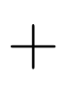
Logistic Regression
c
Soil moisture
Slope
p: probability of landslide
Function of probability
=
Weighted sum of input variables

Slide 3
Logistic Regression puts too much structure
c
Soil moisture
Slope
p: probability of landslide
Function of probability
=
Weighted sum of input variables
Shortcomings:
What if landslide probability is lowest at medium soil moisture?
What if, at high slope, soil moisture does not matter at all?

Slide 4
Decision Tree: an intuitive approach
If …
If …
If …
If …
If …
If …
If …
landslide
No landslide
No landslide
landslide
There are algorithms for identifying the most discriminatory branching.

Slide 5
Random Forest: wisdom of the trees
Random forest = collection of decision trees
Each tree randomly gets different subsets of data and features.
Final output by popular vote (classification), or mean (regression).

Slide 6
Random Forest: wisdom of the trees
Random forest = collection of decision trees
Each tree randomly gets different subsets of data and features.
Final output by popular vote (classification), or mean (regression).
n | elev | cprof | slope | area
1
2
3
4
5
6
7
8
9
Data distribution:
Decision tree 1
Decision tree 2
Decision tree 3
.
.
.

Slide 7
Random Forest: wisdom of the trees
Random forest = collection of decision trees
Each tree randomly gets different subsets of data and features.
Final output by popular vote (classification), or mean (regression).
n | elev | cprof | slope | area
1
2
3
4
5
6
7
8
9
Data distribution:
Decision tree 1
Decision tree 2
Decision tree 3
.
.
.
If …
If …
If …
If …
If …
If …
If …

Slide 8
Random Forest: wisdom of the trees
Random forest = collection of decision trees
Each tree randomly gets different subsets of data and features.
Final output by popular vote (classification), or mean (regression).
n | elev | cprof | slope | area
1
2
3
4
5
6
7
8
9
Data distribution:
Decision tree 1
Decision tree 2
Decision tree 3
.
.
.
If …
If …
If …
If …
If …
If …
If …
If …
If …
If …
If …
If …

Slide 9
Random Forest: wisdom of the trees
Random forest = collection of decision trees
Each tree randomly gets different subsets of data and features.
Final output by popular vote (classification), or mean (regression).
n | elev | cprof | slope | area
1
2
3
4
5
6
7
8
9
Data distribution:
Decision tree 1
Decision tree 2
Decision tree 3
.
.
.
If …
If …
If …
If …
If …
If …
If …
If …
If …
If …
If …
If …
If …
If …
If …
If …
If …
If …
If …
Popular vote

Slide 10
Random forest parameters
1. Number of trees (ntree)
More trees = more stable prediction. But more computation.
2. Number of features (mtry)
More features = capture more complexity.
Generally set to square root(total number of features).
3. Number of samples (sampsize)
More samples = less variability in tress.
4. Node size (nodesize)
Number of samples in smallest branch.
Smaller node size = deeper tree = capture more complexity.

Slide 11
Example: Forest cover type
University of California Irvine forest cover dataset.
Dataset:
physical characteristics + 7 forest cover types (spruce/pine/…).
Data is not linear but has bands:
Forests grow neither in deserts nor in lakes. Need medium soil moisture.
Can we predict cover type from physical characteristics?

Slide 12
Some thoughts on random forests
Very powerful but requires lots of data and hyperparameters.
Very good at handling lots of features and samples, because it distributes across trees.
Useful for non-linear relationships, especially bands.
Not good at extrapolation.

Slide 13


Real example: Digital Elevation Model correction
- Dr. Dennis Wagenaar, (me), Prof. David Lallemant
Elevation data used in many fields, including flood risk assessment.
Global elevation data only available from satellites,
but it captures treetops and rooftops, not the terrain.
Train random forest to estimate top-to-terrain error.
Satellite captures
Actual terrain

Slide 14
Acknowledgments & References
University of California, Irvine for Machine Learning Repository.
https://archive.ics.uci.edu/
Hawker et al. (2022). A 30 m global map of elevation with forests and buildings removed. Environ. Res. Lett. 17 024016
DALL-E for image.
Dr. Dennis Wagenaar and Prof. David Lallement were key contributors to the development of Random Forest-based Digital Elevation Model.

Slide 15
Solution: train random forest on building & forest errors
Methodology builds on Hawker et al. (2022)
Create dataset of errors where real elevation available:
Error = real elevation - satellite-based elevation
Collect global data on forest height, building height.
Train model:
randomForest : error ~ f(location , building data , forest data , …)

Slide 16
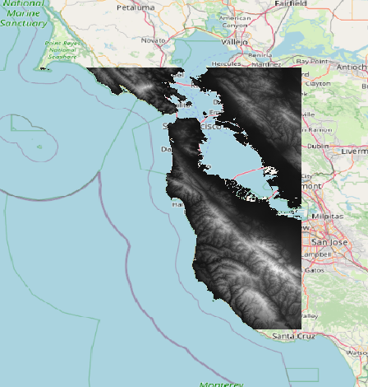
Solution: train random forest on building & forest errors
Methodology builds on Hawker et al. (2022)
Create dataset of errors where real elevation available:
Error = real elevation - satellite-based elevation
Collect global data on forest height, building height.
Train model:
randomForest : error ~ f(location , building data , forest data , …)
Result: our DEM has 50% less error than European Space Agency Copernicus DEM.

